Slide 1

COPS Training
Part 2

Slide 2
Previously:
Providers send 837 files containing claims
Magic, we’ll talk about it later
837 files go through OTVM
Accepted files staged for PEGA Process
Claims are loaded into PEGA
ODW Nightly Load picks up claims
Claims load into GBD Facets
Claims load into FACETS_XC
XC Load
Keywords generated for the new claims
CLMU Load
EIDS Jobs pick up claims

Slide 3
New Terminology
New Day Claims: claims that are coming today
Recycle Claims: claims from previous days
Oracle (SQL Developer): like MS SQL (what we use to run queries), but connects to Facets so we can run queries against Facets

Slide 4
An Overview: with Tidal Jobs
New day: CLA303D and CLA303E
Recycle: CLA301B
MGFT
CLA303B
CLA303B
Providers send 837 files containing claims
Files go through processes with other teams
837 files go through OTVM
Accepted files staged for PEGA Process
Claims are loaded into PEGA
ODW Nightly Load picks up claims
Claims load into GBD Facets
CLMU Load
Claims load into FACETS_XC
XC Load
Keywords generated for the new claims
EIDS Jobs pick up claims
CLA002B, CLA005, and CLA015
CLA002, CLA002B, CLA004A
New day: CLA305A
Recycle: CLA305B

Slide 5
CLA303B – OTVM and PEGA Staging
Starts at 12:30AM
Runs throughout the day until 11:45PM
Takes files from vendor locations and moves them to CIFT/CIRT pickup locations
Moves files into hot folder for OTVM to pickup and moves files to be staged for PEGA
Different vendors have different rules for compliance, OTVM checks each file based on its vendor
Main locations to check: Error queue, outbound queue (no CIFT queues),

Slide 6
The path of the file through OTVM
Vendor Location
CIRT/CIFT Pickup Location
OTVM Hot folder
Staged for PEGA
Prod Location

Slide 7
OTVM Statuses
New- file available, recognized it needs to be updated to be processed
Updated for processing- still in hot folder, file name is updated with .processing extension (meaning it will be picked up)
Waiting for Analysis- staged to be analyzed, but not in hot folder
Analysis in progress- currently going through OTVM with all the rules/policies/exclusion rules applied based on input queue
Analysis complete- file has gone through all rules and policies applied, prepped for error or report generation depending on whether all claims in the file are rejected or not
Error- trash status. Any files that fail to meet structural compliance or files that were abandoned during analysis will have this status. If any are shown with data, research further to identify cause of error
Generating Reports- creating necessary 277, 999s, submitter reports, and newly processed main file
Report Generation Complete- used in the output queue to go to the respective file location in prod

Slide 8
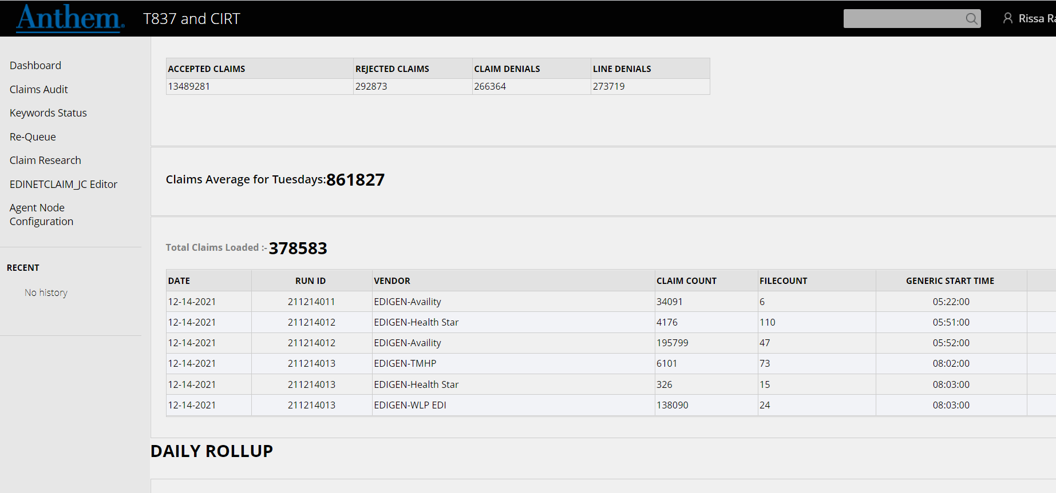
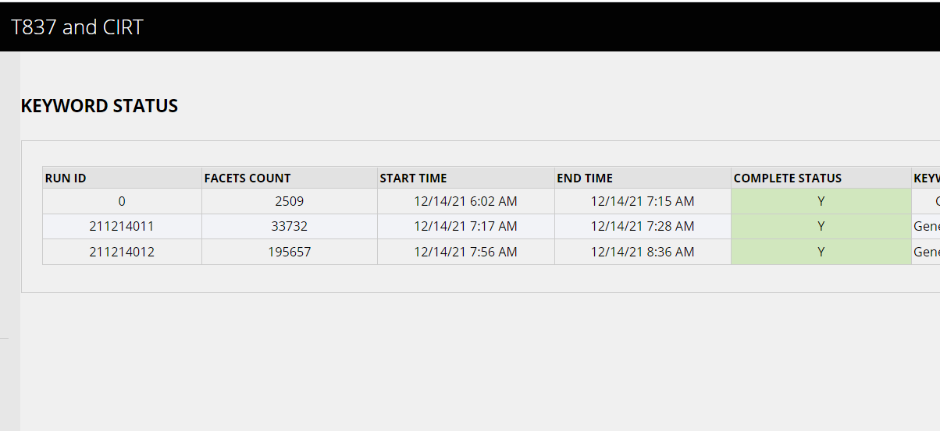
PEGA Load- New Day and Recycle Claims
The PEGA load is the process of loading claims into EDINETCLAIM on EDINET1P
Claims are loaded into 837 tables by the PEGA application
This is monitored on the PEGA dashboard: https://30.96.14.28:8517/prweb/PRServletLDAP1

Slide 9
CLA303D, CLA303E, CLA301B – PEGA Load
The jobs that load the claims are:
CLA303D
Starts at 1AM and runs throughout the day until 5PM
Loads new day claims to PEGA
CLA303E
Starts at 5:15PM
Relies on CLA303D
Loads new day claims to PEGA
CLA301B
Starts at 9PM
Loads recycle claims to PEGA

Slide 10
Keywords
Keywords are how the claims are loaded into Facets
Keywords are organized claim files that are in Trizetto format
The keyword files do not include rejected claims from the 837 files
Keywords are generated from EDINETCLAIM on EDINET1P and processed to Facets through the XC and CLMU loads
We can see how many keywords have been created through the PEGA application

Slide 11
CLA305A, CLA305B - Keywords
The jobs that generate the keywords are:
CLA305A
New Day claims
Starts at 7AM and runs throughout the day until 11:30PM
Relies on CLA305B
CLA305B
Recycle claims
Starts at 6AM and runs until 8:30AM

Slide 12
CLA002 – XC Load
Starts at 1:30PM
Loads claims from EDINETCLAIM on EDINET1P into FACETS_XC on FAC1P by loading Keywords
Loads all keywords generated by CLA305A and CLA305B by 1:30PM into FACETS_XC
Keywords are now staged to move into GBD Facets
During and after this load, claims are still being loaded to PEGA by CLA303D and keywords are still being generated by CLA305A

Slide 13
CLA002B (“The Primary”) – CLMU Load
Loads claims to GBD FACETS
Starts at 2:30PM
If the keyword claims are over 650K by 2PM, kick this job off at 2:30PM
Runs a second XC load, taking keywords that have been created since the 1:30 XC Load (CLA002) and loading them to FACETS_XC
Runs the incremental CLMU Load.
Takes all the keywords that have been loaded into FACETS_XC by the 2 XC Loads and filters them into GBD FACETS
Status as shown in query:
99 – moved to GBD successfully
15 – has been through logic at least once but was not loaded successfully to GBD
16 – has not been through the logic and is not in GBD

Slide 14
CLA004A – Final XC Load
Starts at 8PM
Loads any keywords that have been created since the 3:30PM XC Load (CLA002B) into FACETS_XC
Does the same thing as CLA002

Slide 15
CLA005 - Cleanup
Second CLMU Load
Scheduled for 6:45PM
Relies on CLA004A so will start after that
Picks up “new day claims” from XC load in CLA004A to load them into GBD FACETS
Also looks at pending claims from past days and loads them into GBD Facets
Different from CLA002B CLMU load because it looks at past days’ claims as well that weren’t loaded to GBD FACETS

Slide 16
CLA005 - Cleanup
If this is killed for CLA009, set it to completed normally so the jobs after it can run. Any claims not picked up will be picked up during cleanup the next day

Slide 17
CLA015 – CLMU Weekend Cleanup
Has no SLA
Cannot be run during deployments/maintenances occurring on Saturdays
Normally starts at 7PM
Can be started earlier if there is maintenance
Does the same thing as CLA005, just on Saturdays

Slide 18
CPC009A, B, and C - CKMM
Payment processing
CPC009A – Weekday CKMM job (M-F)
CPC009B – Saturday CKMM job
CPC009C – Ad hoc CKMM job (only inserted into schedule as needed)
Cleanup job (CLA005) can and should be killed to allow this to run
We care more about making the day’s payments than having the claims delayed by one day in getting loaded to Facets

Slide 19
A Detailed Overview with Tidal Jobs by day of the week
New day: CLA303D and CLA303E
Recycle: CLA301B
New day: CLA305A
Recycle: CLA305B
MGFT
Monday-Saturday
CLA303B
CLA303B
Providers send 837 files containing claims
Files go through processes with other teams
837 files go through OTVM
Accepted files staged for PEGA Process
Claims are loaded into PEGA
Keywords generated for the new claims
Sunday
CLMU Load
XC Load
Saturday
The Weekend Cleanup – Loads new day and previous day claims to GBD Facets
Final XC Load- Claims load into GBD Facets
Monday-Friday
CLMU Load
CLA015
XC Load
CLA004A
CLMU Load
XC Load
CKMM – Determines how much Anthem will pay
The Cleanup – Loads new day and previous day claims to GBD Facets
Final XC Load- Claims load into GBD Facets
XC Load
The Primary – runs an XC load then a CLMU load
Claims load into FACETS_XC
CPC009A
CPC009B
CPC009C
CLA005
CLA004A
CLA002B
CLA002
EIDS Jobs pick up claims
ODW Nightly Load picks up claims

